Slide 1
Learning Neural Templates for Recommender Dialogue System
Reported by 张城阳 赵凯

Slide 2
1. Introduction
2. Model
3. Experiments
4. Idea

Slide 3
Advantages of Conversational Recommendation System

Slide 4
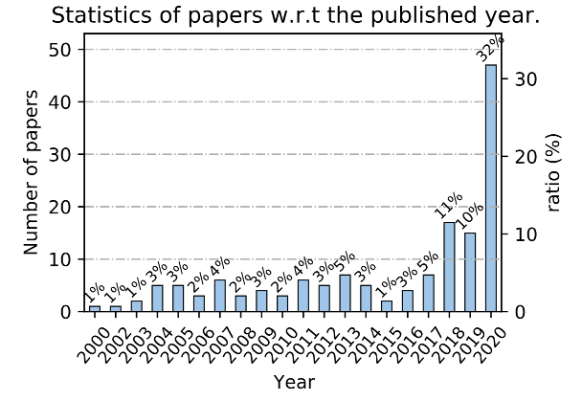
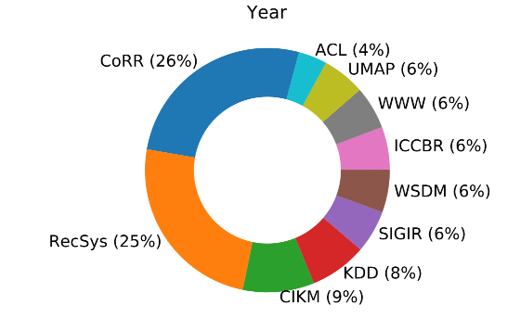
Conversational Recommendation System
DBLP上关于“Conversation* Recommendation*”的统计
Advances and Challenges in Conversational Recommender Systems: A Survey

Slide 5
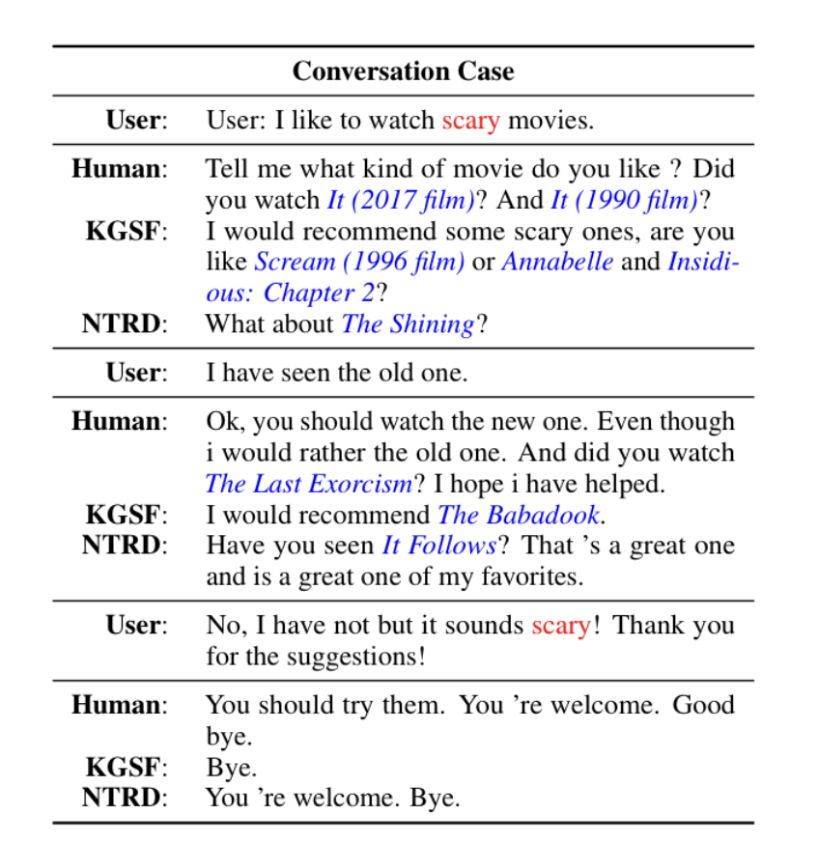
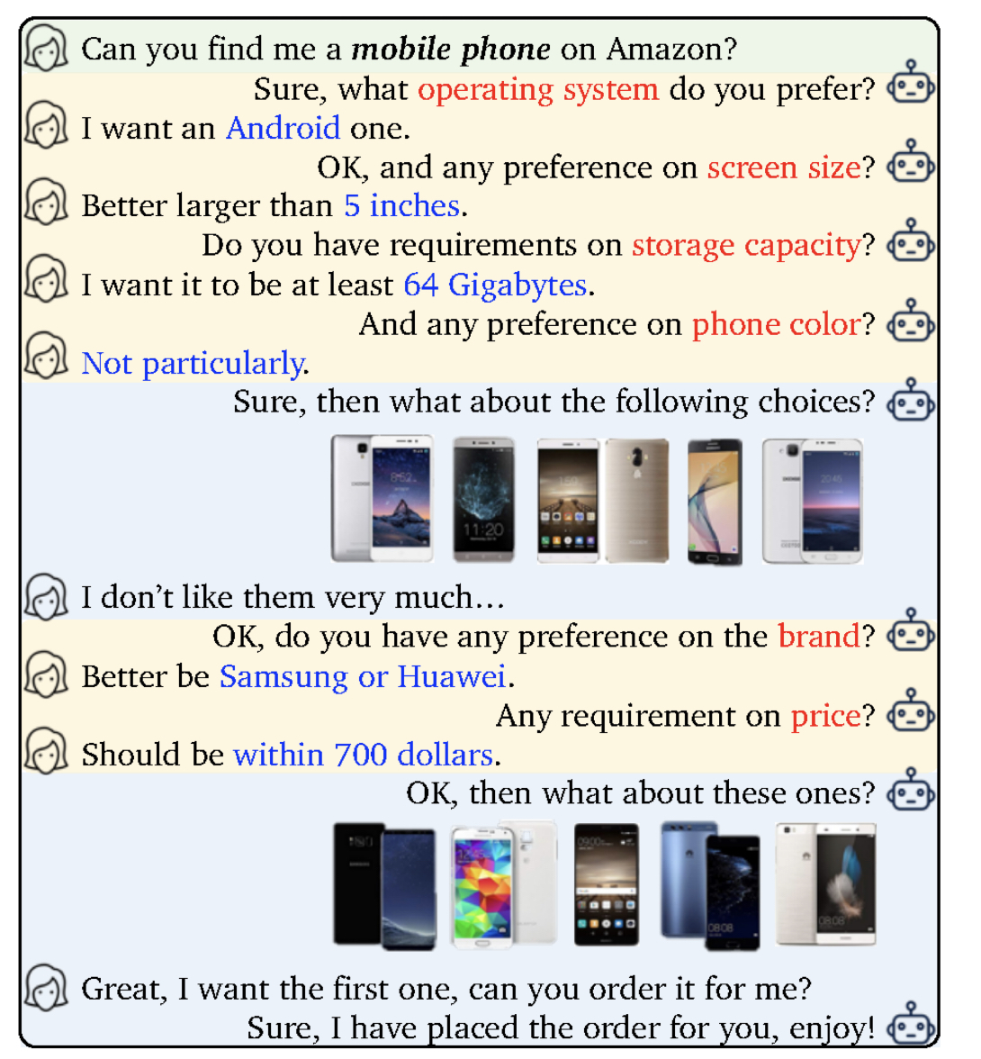
Conversational Recommendation System
Attribute-Based CRS
Generated-Based CRS

Slide 6
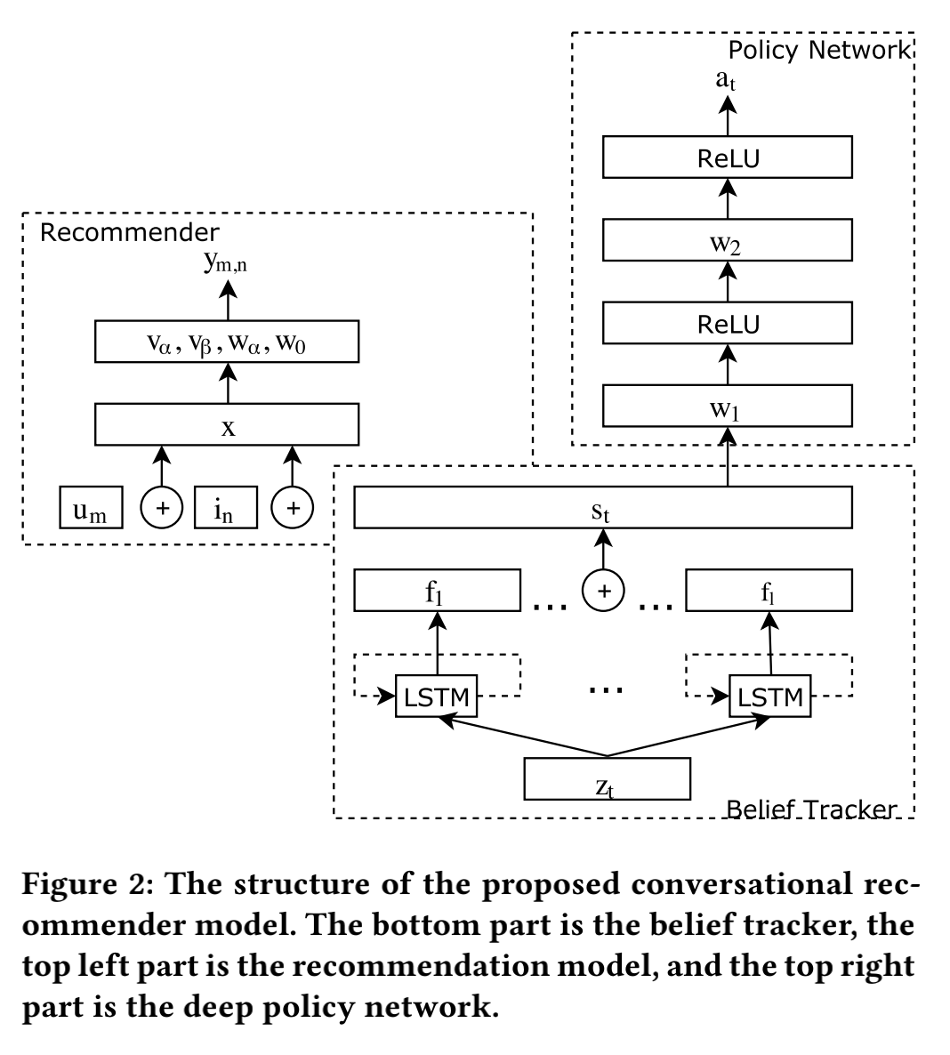
Conversational Recommender System
Attribute-Based CRS

Slide 7
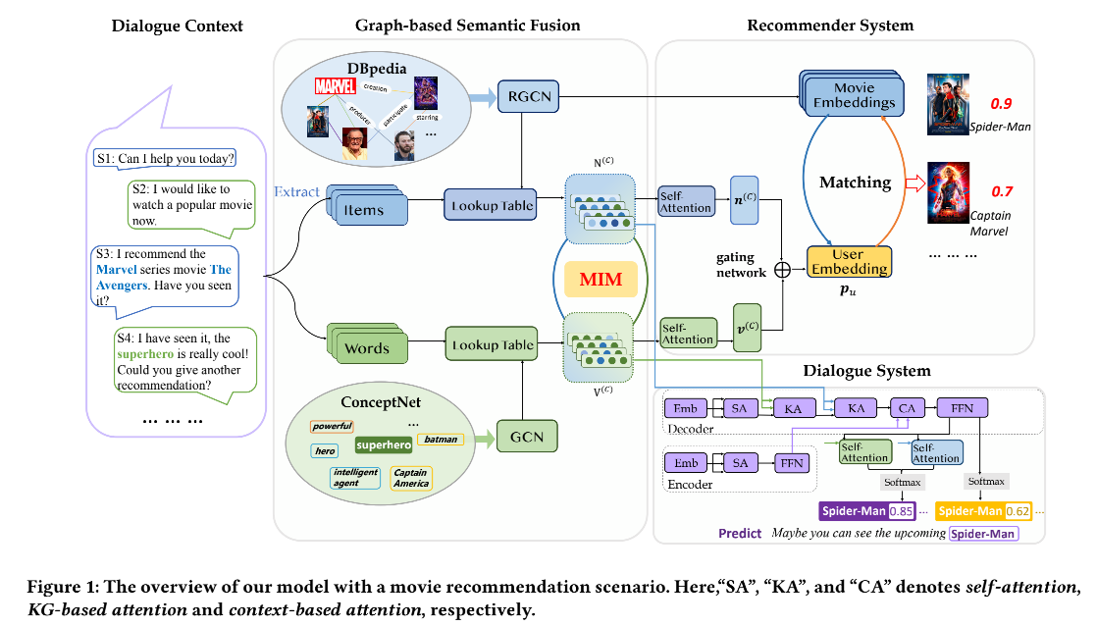
Knowledge Graph based Semantic Fusion
Generated-Based CRS

Slide 8
Introduction
Two key challenges:
The recommended items cannot be always incorporated into the generated replies precisely and appropriately.
Only the items mentioned in the training corpus have a chance to be recommended in the conversation.

Slide 9
Introduction
NTRD:
It decouples the dialogue generation from the item recommendation.
Response template generator adopts an encoder-decoder model to generate a response template with slot locations tied to target items.
Item selector fills in slot locations with the proper items using a sufficient attention mechanism

Slide 10
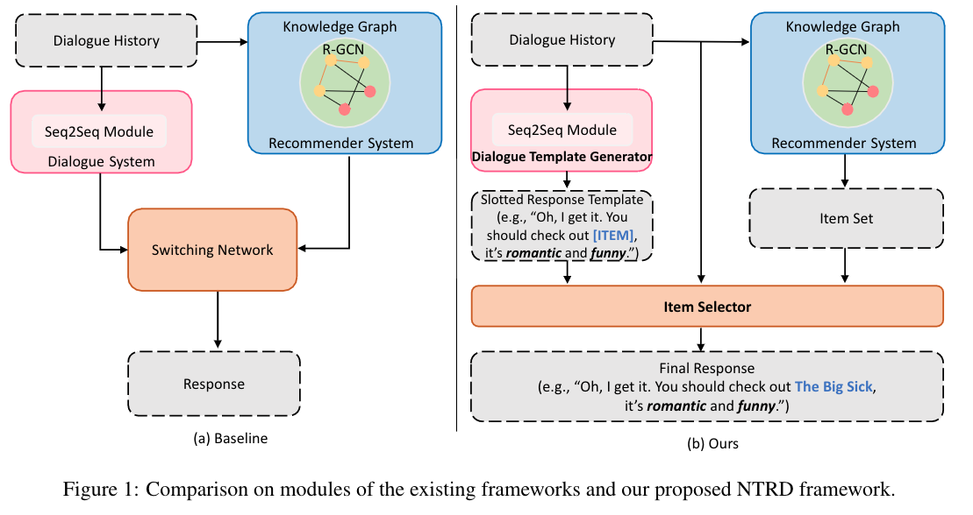
Model

Slide 11
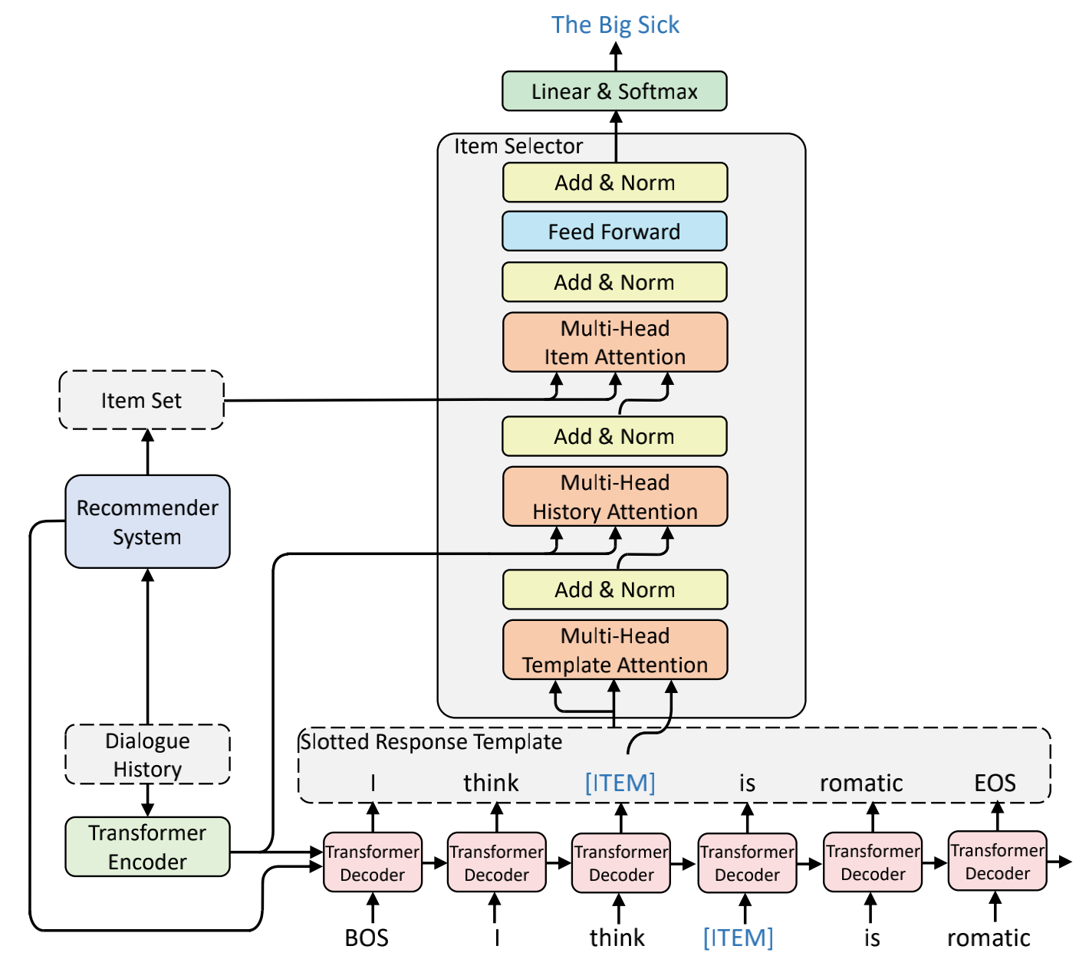
Model
The recommender module learns a user representation Pu through incorporating two special knowledge graphs,
and hm is the learned embedding for item m.

Slide 12
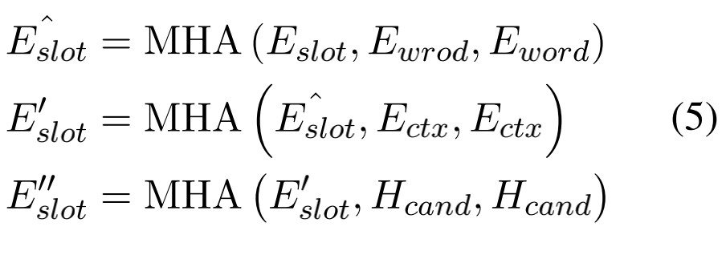
Model

Slide 13
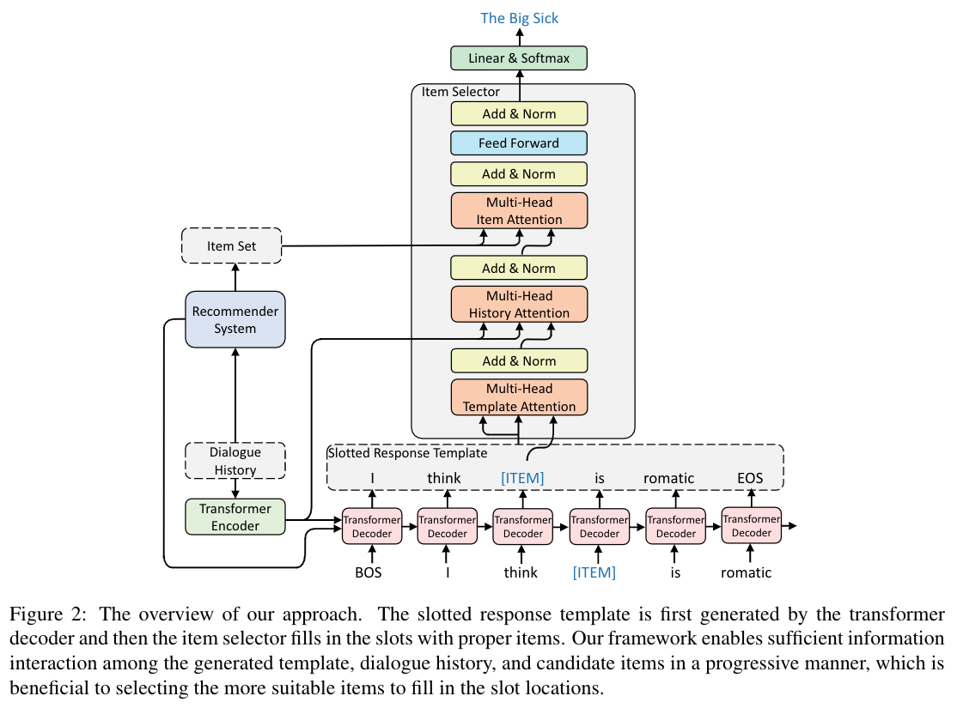
Model

Slide 14
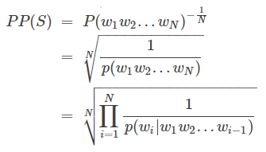
Experiments
PPL (perplexity)
用于估算一句话出现的概率，即句子出现的概率越大，困惑度越小，语言模型越好。
计算每一个单词得到的概率倒数的几何平均，即平均分支系数，所以PPL也可以理解为模型预测下一个单词时的平均可选择的单词数量。
概率倒数：句子越好，概率越大，困惑度越小。
n次根号(几何平均数)：对长短句公平、避免某个概率过小
https://zhuanlan.zhihu.com/p/114432097?ivk_sa=1024320u

Slide 15
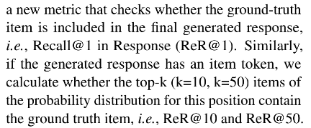
Experiments
Dist-2
句子：w1 w2 w1 w2 w3
dist-2 = 3/4
ReR@1
Recall@ 1 in Response

Slide 16
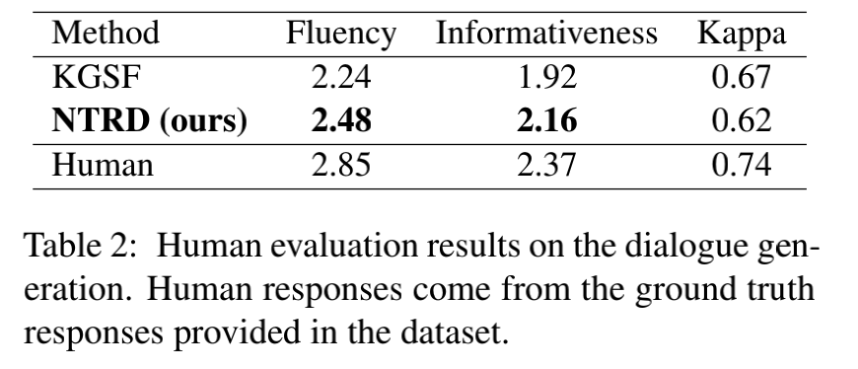
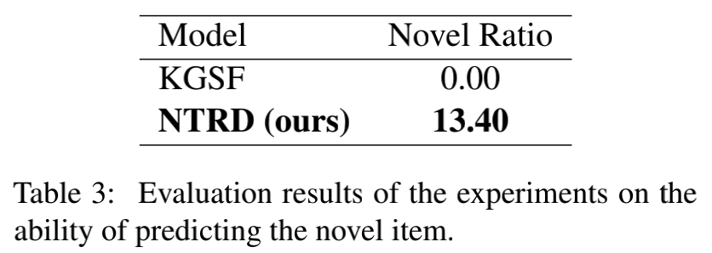
Experiments

Slide 17
Idea
细粒度[ITEM]
引入用户历史交互数据
[ATTRIBUTE]配合Insertion Transformer
https://arxiv.org/abs/1902.03249

Slide 18
Expansion

Slide 19
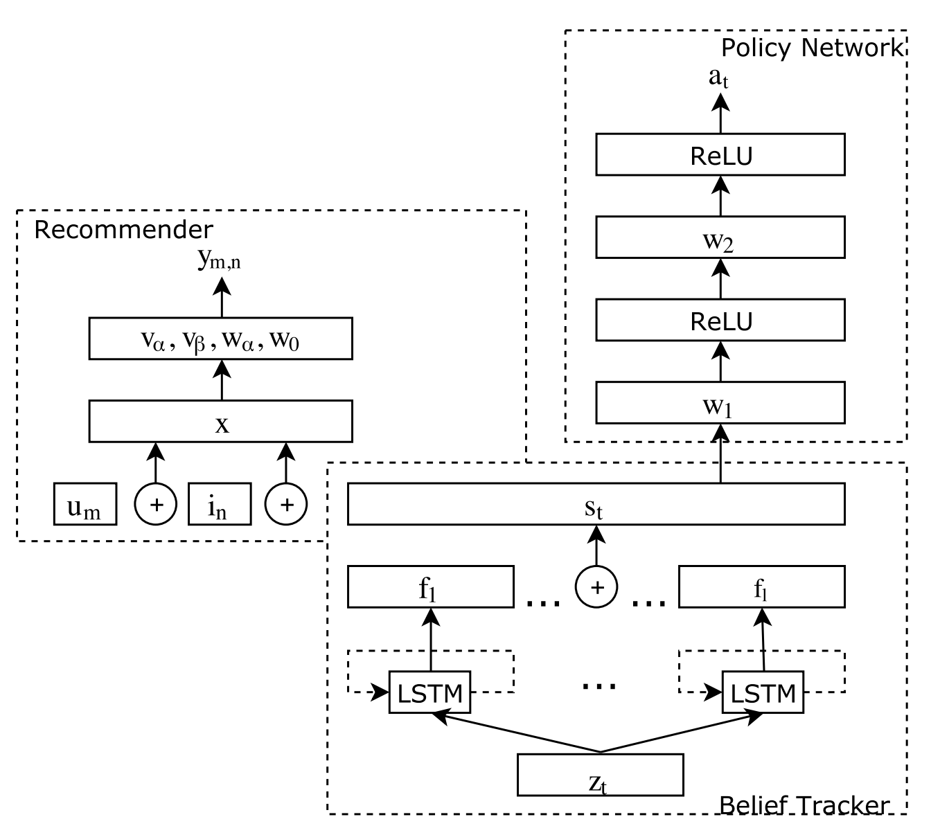
单轮场景 Conversational Recommender System 【SIGIR 2018 】
利用n-gram将用户话语转为向量
将话语1到话语t作为上文进行合并
上文1到t转为概率
串联后得到目前的用户置信(状态)
拼接三者
二路因子分解机(2-way FM):输出用户对推荐物品的预测评分
用户标识向量的One-Hot
物品标识向量的One-Hot

Slide 20
单轮场景 Conversational Recommender System 【SIGIR 2018 】
策略模块：
状态空间为会话上下文描述，即置信度s
动作空间为 l+1，l表示属性种类。
奖励：假设用户查看推荐列表时，看到第K个就停止；目标物品越靠前，奖励越高。
该论文根据目标物品位置在列表的位置，对奖励建模了三种：线性、NDCG、Cascade。
强化学习的策略梯度公式
G是从回合t到结束T的奖励总和

Slide 21
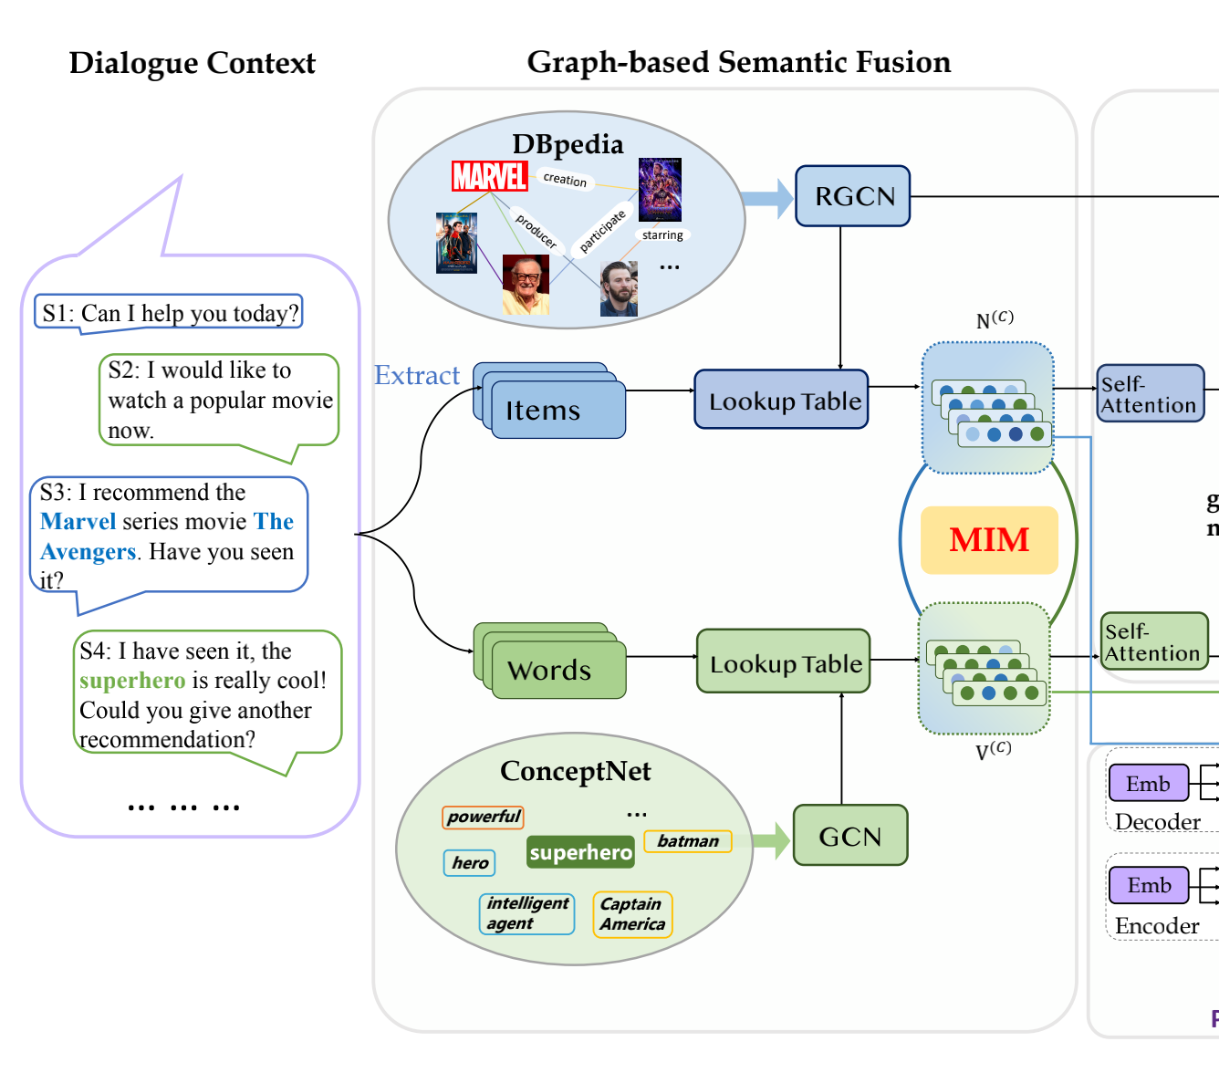
Knowledge Graph based Semantic Fusion
GCN
RGCN

Slide 22
Knowledge Graph based Semantic Fusion
Mutual Information Maximization

Slide 23
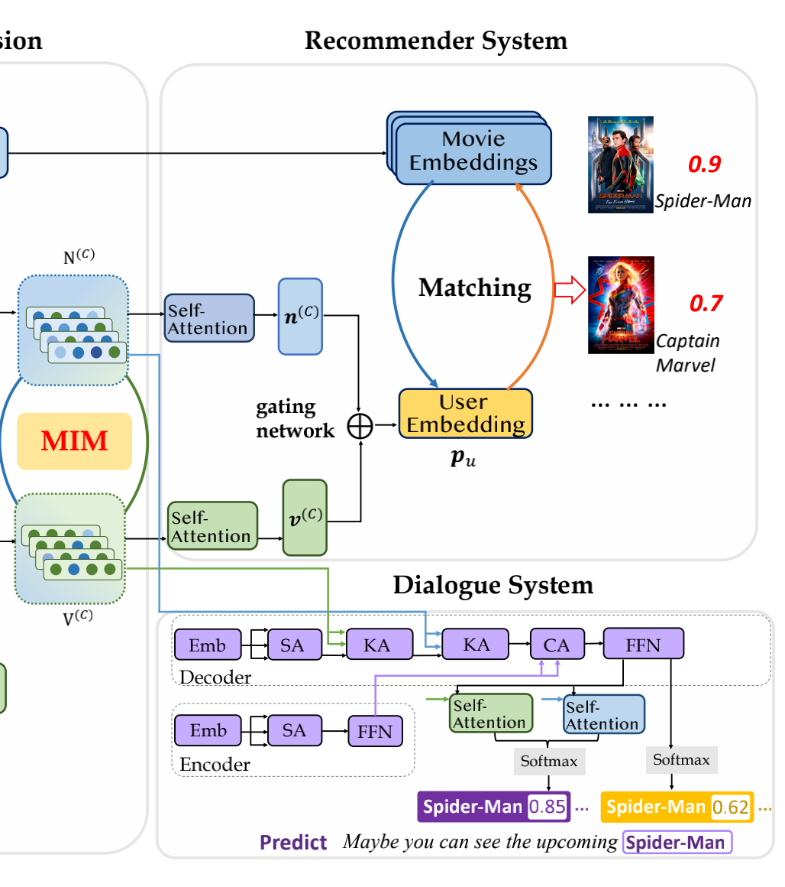
Knowledge Graph based Semantic Fusion
KG-enhanced Recommender Module

Slide 24
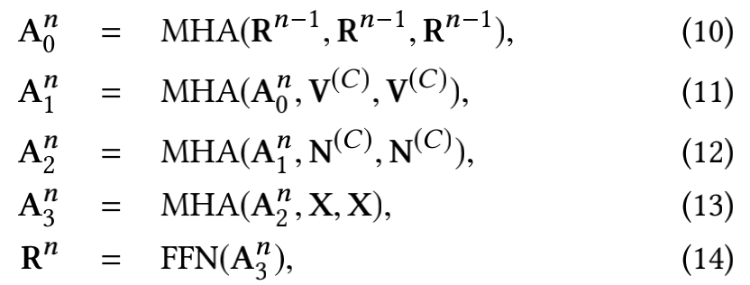
Knowledge Graph based Semantic Fusion
KG-enhanced Response Generation Module

Slide 25
Knowledge Graph based Semantic Fusion
KG-enhanced Response Generation Module

